Slide 1

MIS 776 Business Analytics
Presented by Michael J Lee, PhD

Slide 2
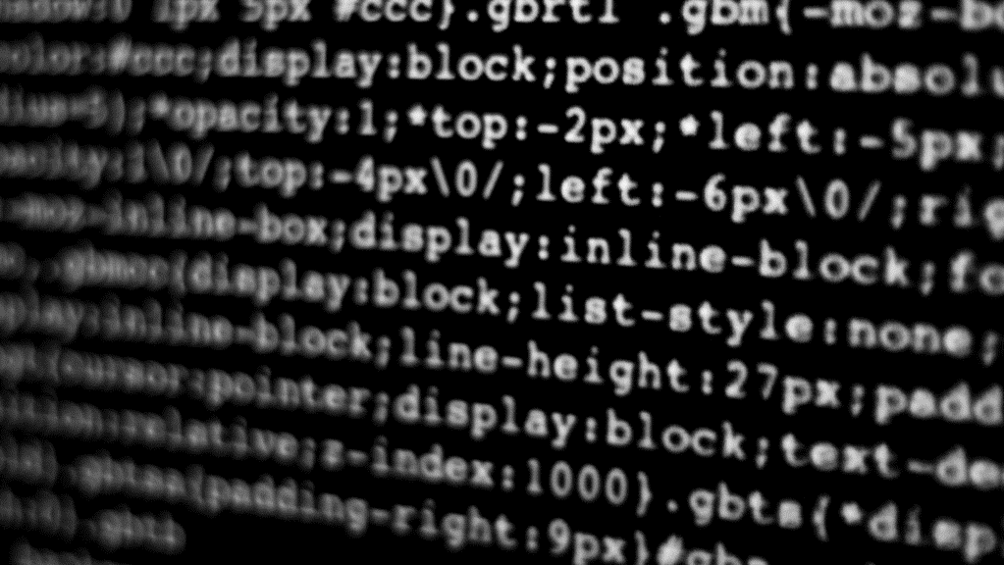
Introduction to Neural Networks and Deep Learning

Slide 3

Class Business
Don’t forget that the midterm exam is next week (starting Oct 7), so make sure that you plan some time to work on this.
For traditional path students
The exam is timed to 2 hours.
You can start the exam at any time during the week, but one started, you must submit your work within 2 hours.
The exam will be a combination of conceptual and programming questions. All questions will ask you to apply what we have learned to typical business scenarios.
No programming assignment this week. Spend your time with your groups and preparing for the midterm.

Slide 4
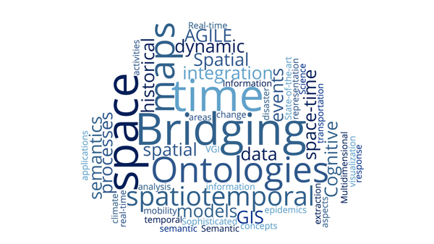
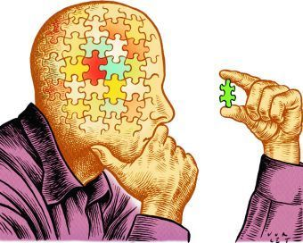

What are humans good at?

Slide 5
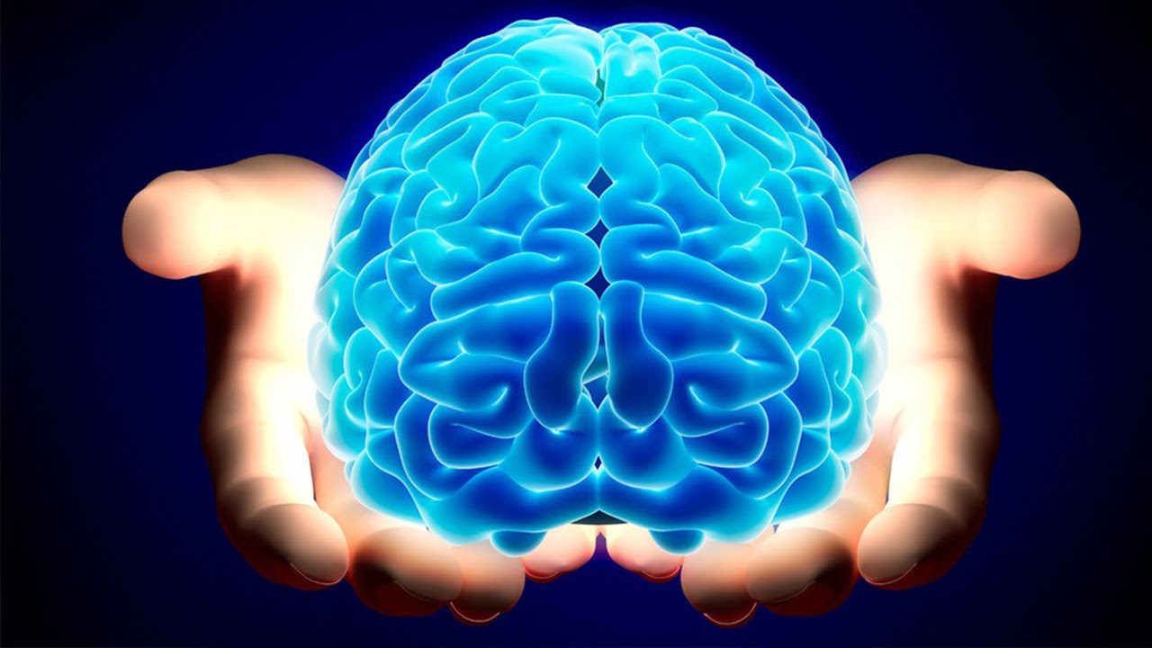

Slide 6
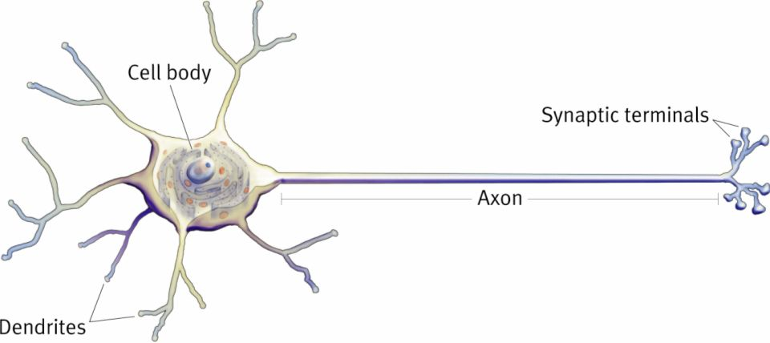
What is a Neural Network?
Concepts: All or None (binary effect)
Cumulative Influence
Synaptic Weight

Slide 7
What is a Neural Network?
(Synaptic) Weights
This is what we get
Inputs
X₁
W₁
(Cumulative Influence) Summer
$$Z= f (\overline{X}, \overline{W}, T)$$
Threshold
$$Σ$$
X₂
W₂
Z _{(0 .. 1)}
$$D= g (\overline{X})$$
X₃
W₃
This is what we want

Slide 8
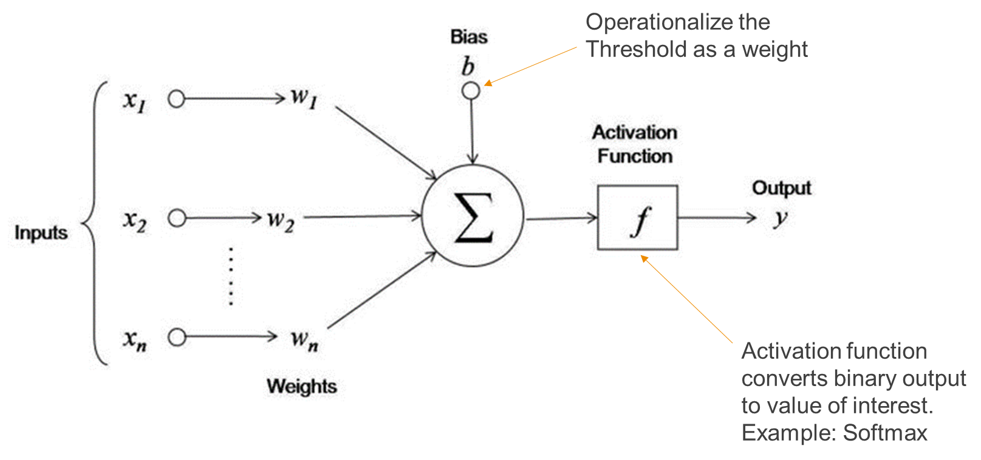
What is a Neural Network?

Slide 9
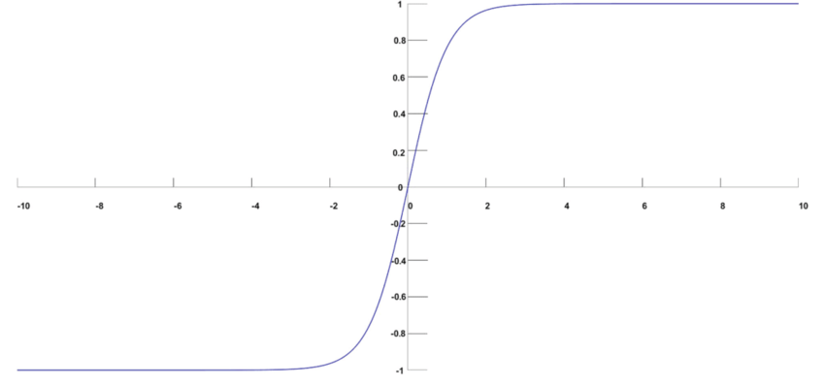
Softmax Function
Takes input as a vector of real numbers
The values from the last neuron layer
Converts these values into a probability distribution of potential outcomes
Probabilities sum to 1
When probabilities reach prescribed threshold, the result is activated
Based on an exponential relationship of inputs

Slide 10
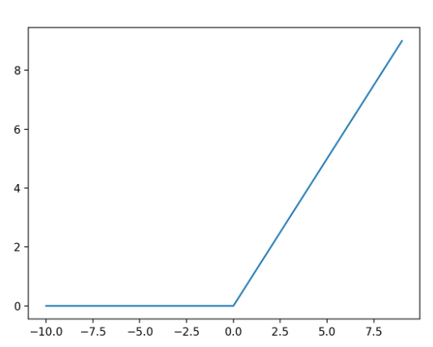
Rectified Linear Unit (RELU) Function
Like Softmax, it takes the inputs from the last neuron layer
Converts these values into a linear outcome
Instead of probabilities, it uses a hard threshold.
Will activate when hard threshold is reached
Unlike Softmax, large values do not always snap to 1, making it easier to differentiate values at higher levels.

Slide 11
Typical Neural Network Process
Transform input to expected format.
Pass the input data to the input layer of the network.
The network applies some logic (dependent on the network type) which includes a set of weights.
The network generates a predicted result.
The predicted result is compared with the actual result, which will result in some level of error.
Reconcile the error backward through the network (back propagation) to adjust the weights.
Repeat steps 3-6 until a stopping rule is reached. This is the final model.
To use the model, provide a new unseen input and the network will generate a prediction

Slide 12
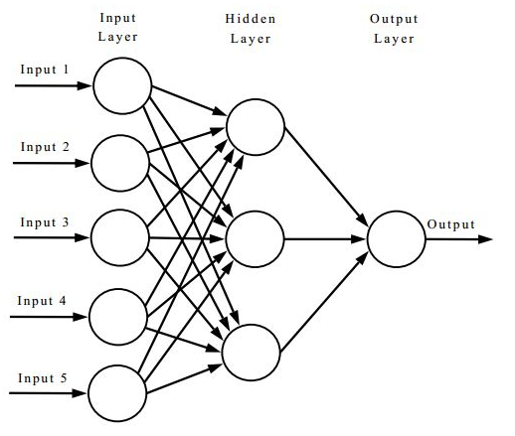
Multilayer Perceptron

Slide 13
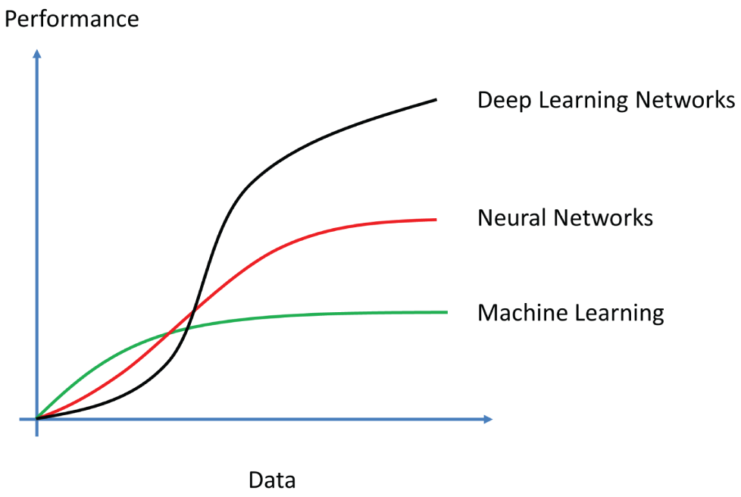
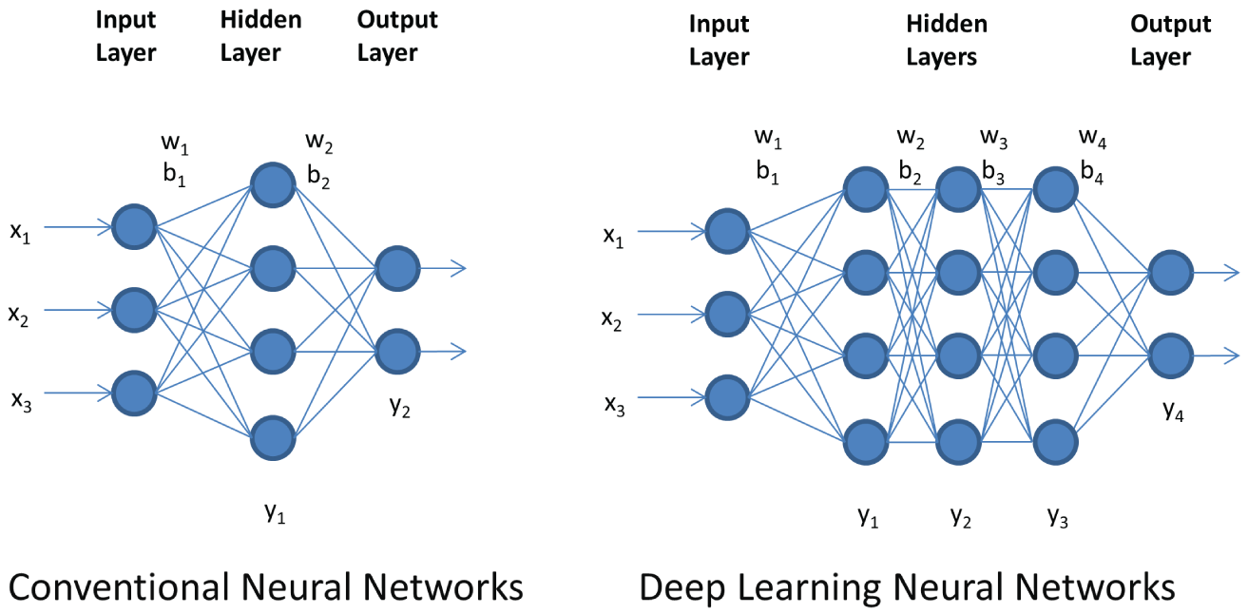
Technologies and Distinctions

Slide 14
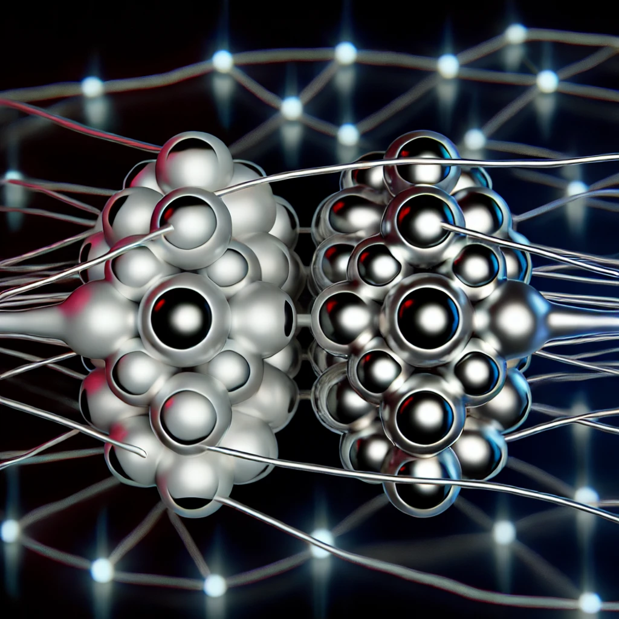
Useful Types of Deep Learning Networks
Convolutional Neural Networks
Image Classification
Text Classification
Recurrent Neural Networks
Useful for sequencing
Formerly used with text, but essentially replaced by transformers
Transformers
Pretrained models / transfer learning
BERT and its variations
GPT (generative pre-trained transformer)

Slide 15
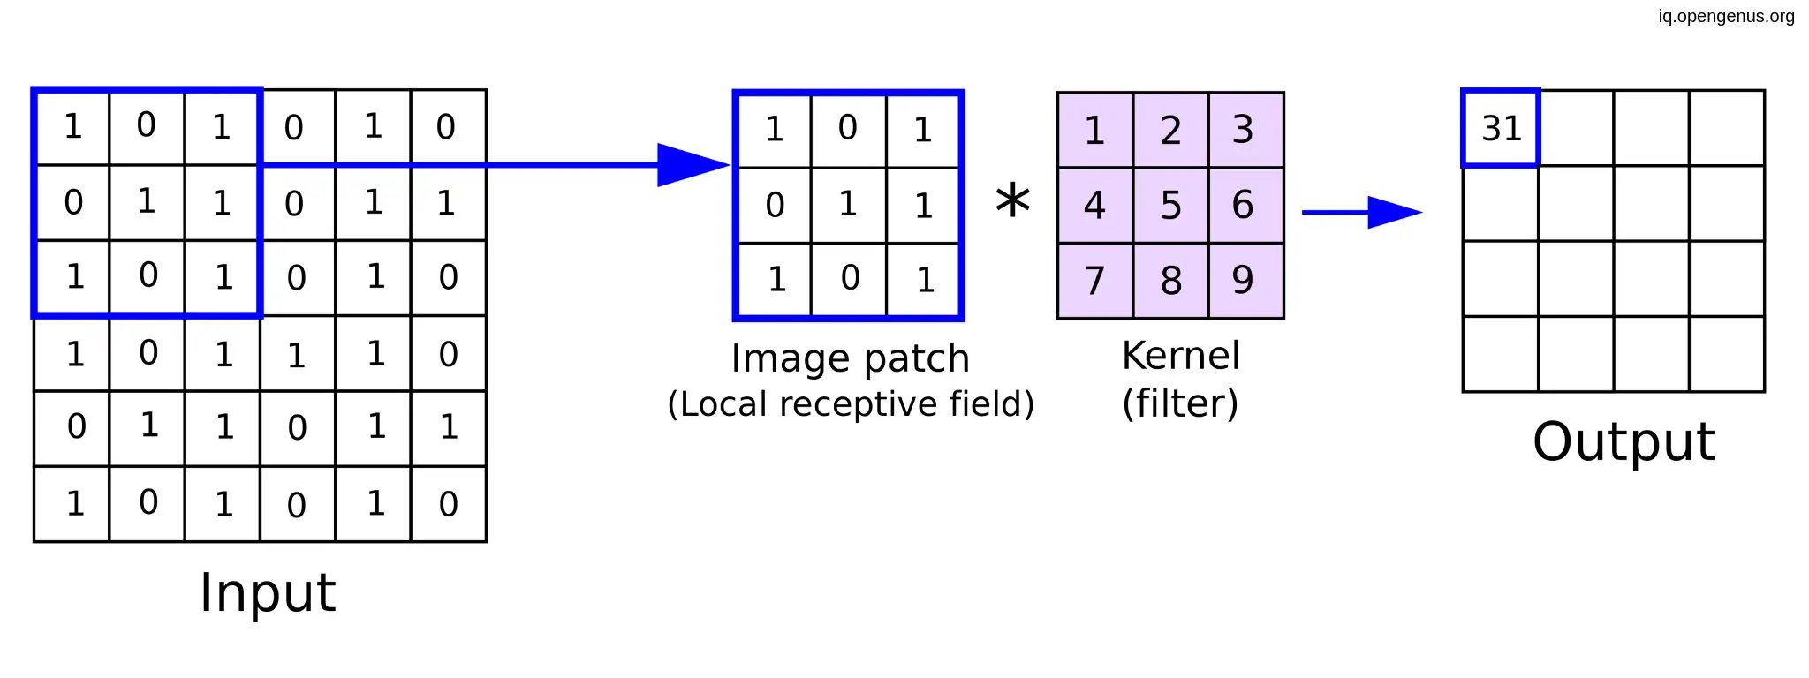
How Convolution Works
Source: https://www.superannotate.com/blog/guide-to-convolutional-neural-networks

Slide 16
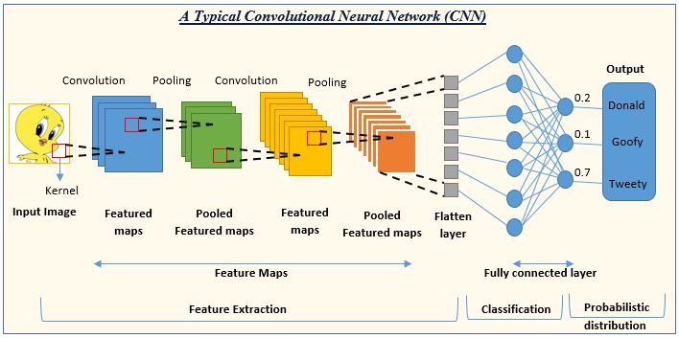
Convolutional Neural Networks (CNN)
A multilayer deep learning network used to identify patterns in multidimensional data structures such as images or word embeddings.
Comprised of multiple layers:
Input layer
Convolution layer
Pooling layer
Dropout layer
Flattened Activation layer
Fully Connected layer
Output layer
Source: https://www.analyticsvidhya.com/blog/2022/01/convolutional-neural-network-an-overview/

Slide 17
Demo
Convolutional Neural Network with TensorFlow

Slide 18
Recurrent Neural Networks (RNN)
Recurrent neural networks are useful for processing sequence data including:
Text
Graphs (network diagrams such as Facebook or X (Twitter))
Events (time series data)
Previously, the most common use of RNNs was for text (natural language processing), however this application has been almost entirely replaced by transformers, so I will not cover them in detail.
If you want to learn more, here is a good explanatory video: https://www.youtube.com/watch?v=LHXXI4-IEns

Slide 19

Transformers
Originally developed by Hugging Face (https://huggingface.co/)
There are two primary types of transformers
BERT (Bidirectional Encoder Representations from Transformers) and its variants such as:
ALBERT: (A Lite BERT)
RoBERTa: (Robustly Optimized BERT)
ELECTRA: (Efficiently Learning an Encoder that Classifies Tokens Accurately)
DistilBERT: Simplified BERT
TinyBERT: Further simplified beyond DistilBERT
GPT (Generative Pre-trained Transformer)
Initiated by OpenAI, with new variants developed by Microsoft (Copilot), Google (Gemini), etc.

Slide 20
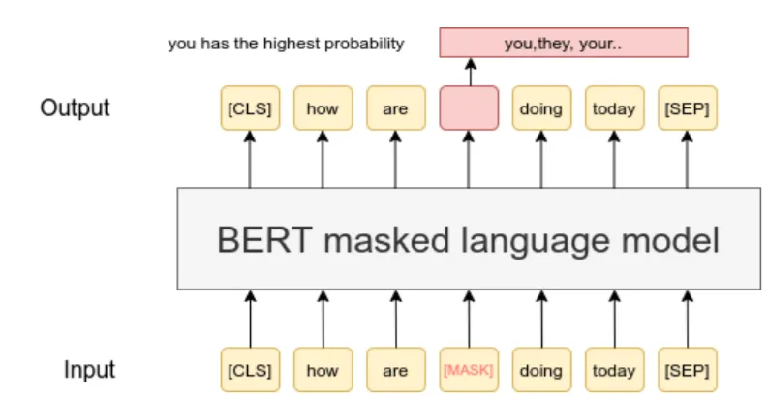
BERT Basics
Uses a pre-trained model with transfer learning (BERT was designed with 110 million parameters)
Instead of sequences, BERT employs a contextual approach
Using masking, it determines the probability of a word occurring in that position based on its context.
This technique provides for a variety of implementations, including:
Classification
Next word / sentence prediction
Contextual text generation
Can be fine-tuned for specific applications

Slide 21
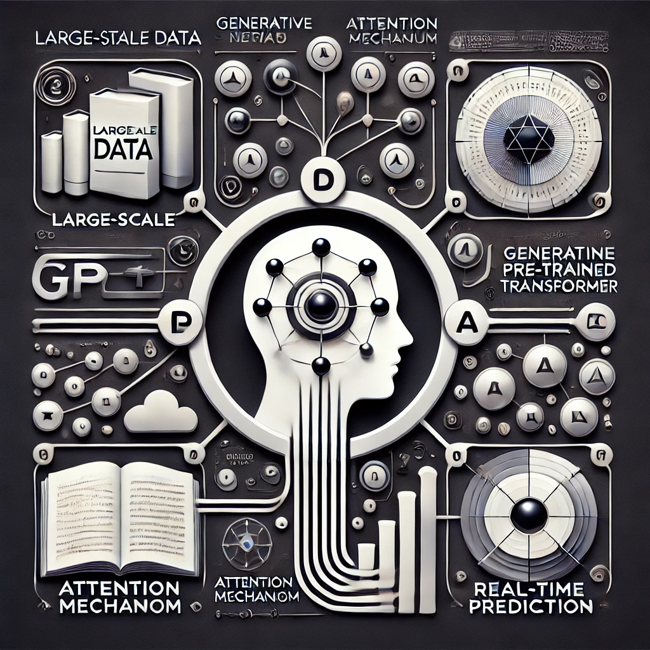
GPT Basics
Also uses concept of transformers, but more robust than BERT
GPT-2 had 1.5 billion parameters
GPT-3 had 175 billion parameters
GPT-4 parameter number never confirmed, but estimated to be 1.8 trillion parameters
GPT-5 is not yet released, but the estimate is that it should be about 17.5 trillion parameters
Provides responses by predicting which words, phrases, or sentences are most likely to be associated with a provided input (based on the data upon which it is trained).
Other non-OpenAI incarnations work in a similar way, however they would behave differently because they would have been trained on a different corpus

Slide 22
How does GPT Work?
1) User Input:
The process starts when the user inputs a query or prompt into the system.
2) Input Processing:
The text input is tokenized (split into manageable pieces).
The system may apply preprocessing steps like normalization.
3) Model Processing:
The preprocessed input is fed into the trained model (from Phase 1).
The model processes the input through multiple layers of transformers.
The system computes attention scores to determine which parts of the input are most relevant.
4) Prediction:
The model generates a probability distribution over possible next tokens or outputs.
Based on the probabilities, the system selects the most likely token(s) to continue the conversation.
5) Output Generation:
The selected tokens are converted back into human-readable text.
The system constructs the response from the chosen tokens.
6) Output:
The final text is outputted to the user as the system's response.
7) End:
The process concludes, waiting for further user input.
Note: This list was generated by GPT-4

Slide 23

Assignments for this week
Stay current on the reading
Xiao Chapter 4
Discussion 6
Reminder: Initial post due on Wednesday @ 11:59 PM
Follow-up posts due on Sunday @ 11:59 PM
No Coding Assignment
Prepare for the midterm
Start collaborating with your groups

Slide 24

Questions?
Contact me via Web Campus
Or email at:
michael.j.lee@unlv.edu

